Slide 1
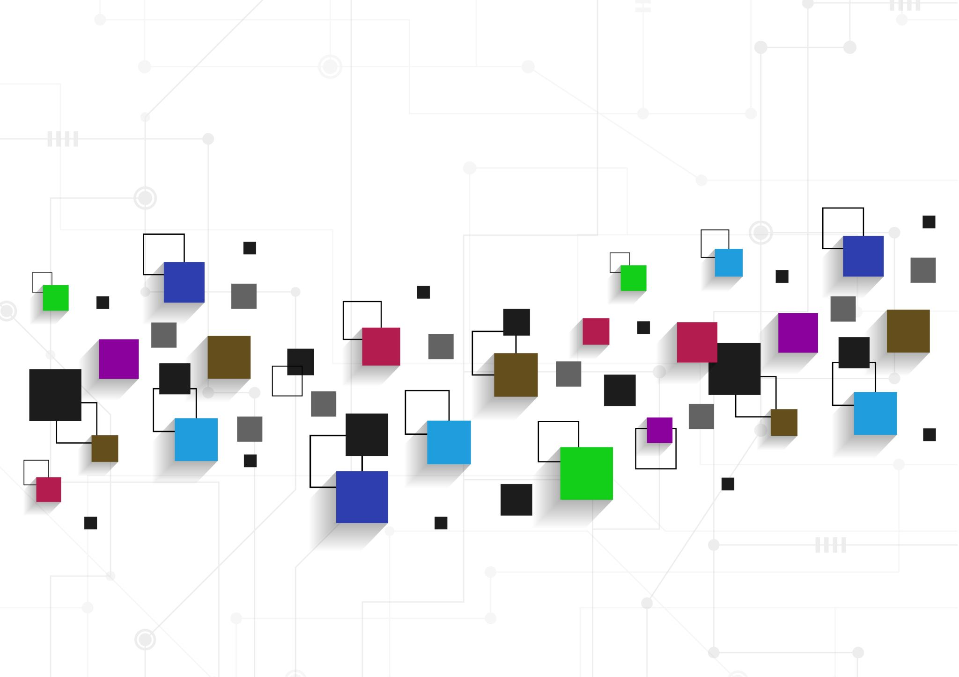
Internet of Things (IoT) and Smart Cities
Marshall Smith
Dr. Yasser Alginahi
11/25/23
Adrian College

Slide 2
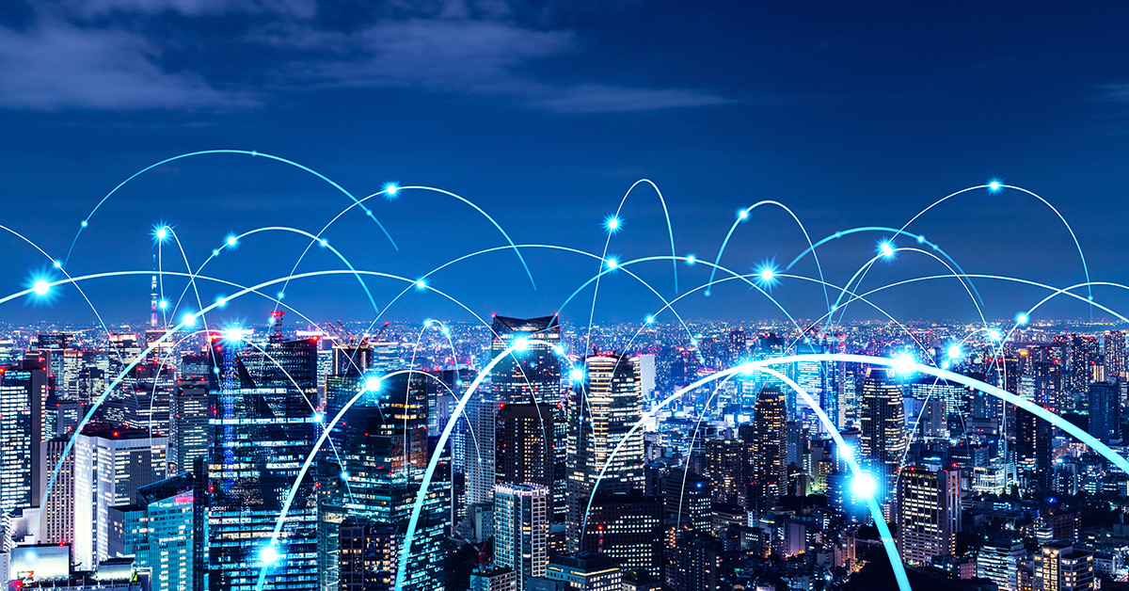
What is a Smart City?
A Smart City utilizes communication technology and data collection
This is made to increase the overall efficiency of the city
Use advanced technology to make citizen’s lives easier, make the environment cleaner, and ensure public safety

Slide 3
Examples of Smart Cities
Paris
London
New York City
San Francisco

Slide 4
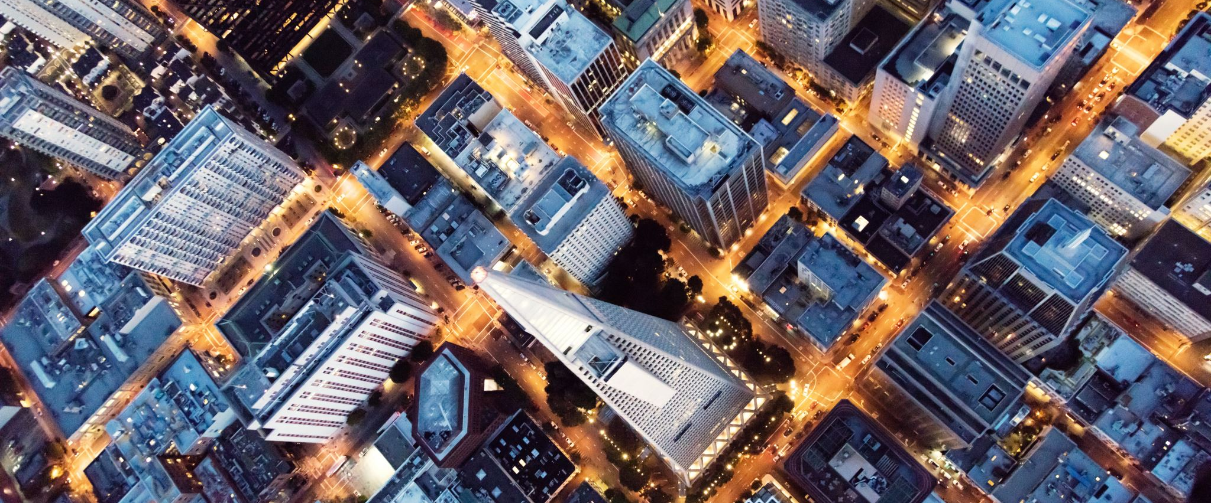
Application within European Cities
Paris: Vincent Callebaut Architectures are building skyscrapers that are made to produce positive energy output [1]
London: Sensors are placed within multiple streets to keep track of what spaces are available for citizens to park in. “Smart Parking”

Slide 5
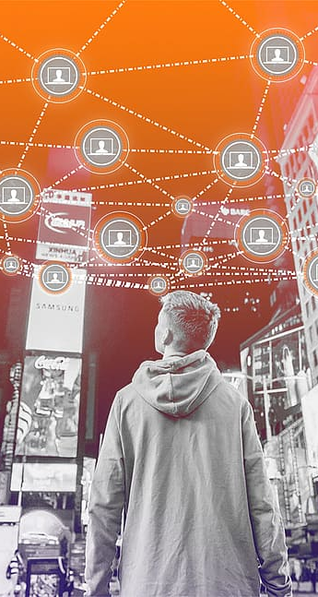
Application within the United States
New York City: Working to get all citizens and technology on the same electrical grid
This is so notifications can be sent out to alert citizens of potential obstacles in their commute
San Francisco: Working to connect all traffic signals to increase the flow of traffic
Means that driver won’t be stopped every block by a red light

Slide 6

What is Internet of Things (IoT)?
Describes the network of physical objects or ‘things’ that are embedded embedded with technologies
These technologies include sensors, software, and other technologies
The technologies are for the purpose of connecting and exchanging data with other devices and systems [2]

Slide 7
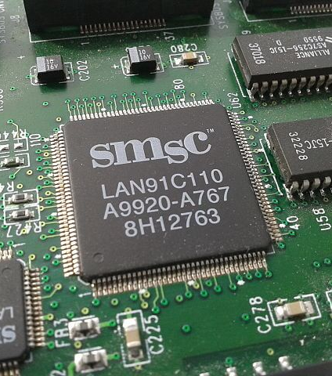
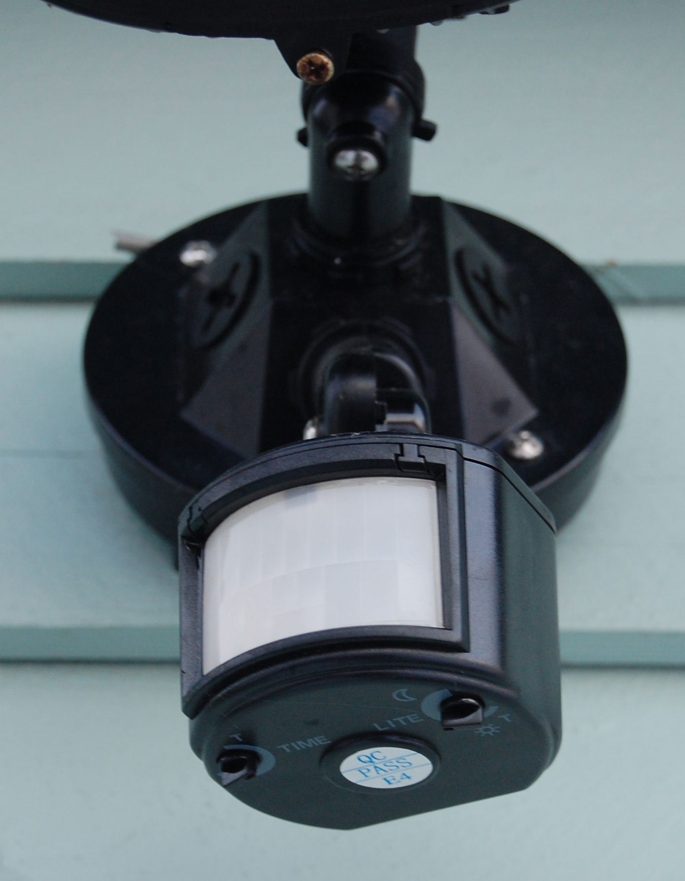
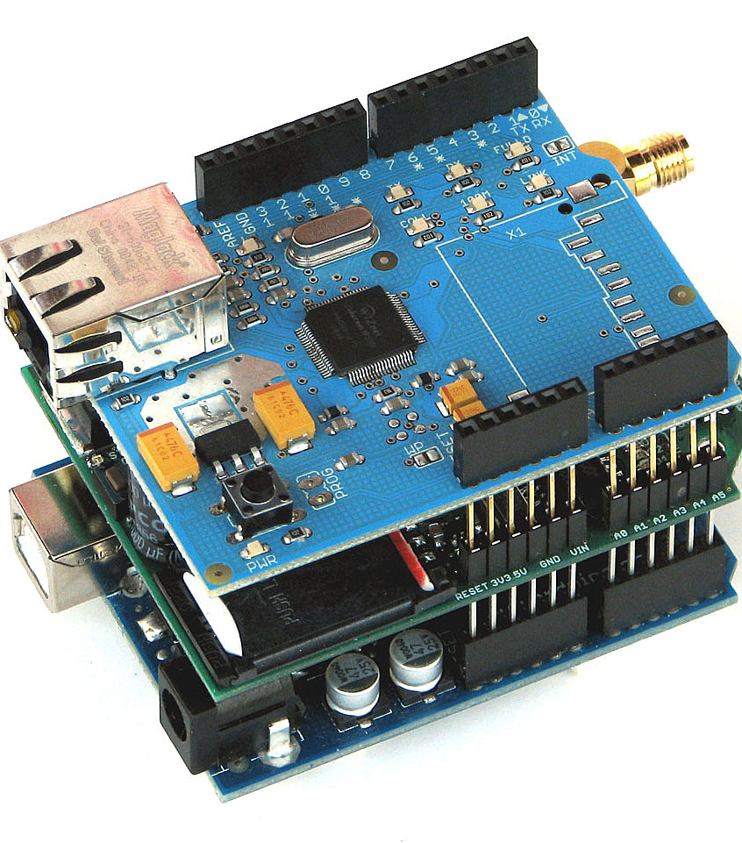
IoT Technologies
Sensors
Software technologies
Machine learning
Microcontrollers
Embedded Systems

Slide 8
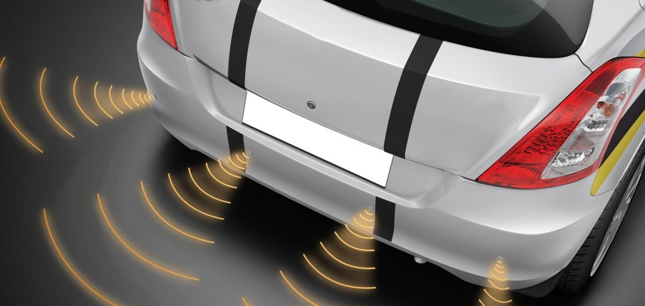
Usage of Technologies
Sensors: Can measure and monitor temperatures within a workplace, along with air pressure and humidity
A motion sensor within a doorbell could alert homeowners of movement on their front porch. (Alert of intrusions)
General Motor sensor

Slide 9
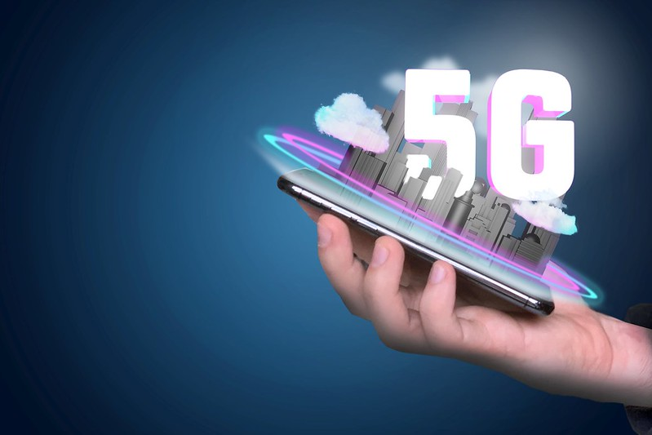
Usage of Technologies cont.
Communication Tools: include 5G, LTE, and Wi-Fi and enables devices to connect to them to receive, send, and transmit data
This helps with machine-to-machine communication as well as device management
Software Technology: database software to make all devices run smoothly
Implemented for data storage, signal processing, machine learning, and artificial intelligence

Slide 10
“Smart city technology can make cities more effective and efficient, which is necessary given the projected rapid growth in urban populations over the next few decades [3].”
- Mark Warner

Slide 11
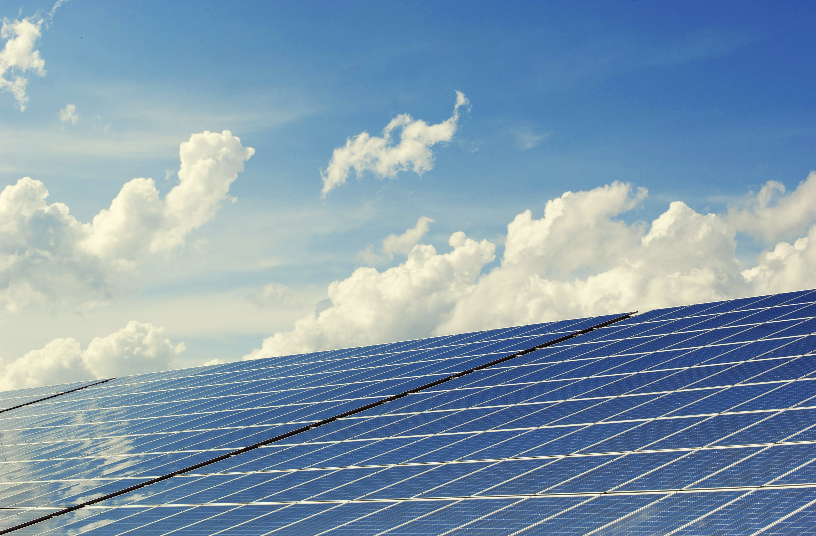
Benefits of Smart Cities
The evolution of IoT technologies help citizens, businesses, and cities save money through energy storage and conservation
These technologies help reduce pollution within the city’s ecosystem by encouraging recycling. (Automated Messages)
Smart cities are important within society because they work to make everyday tasks easier and more efficient

Slide 12

Benefits of Smart Cities cont.
The technology applied within smart cities can help improve air quality which in turn leads to a better quality of life
Technology within smart cities helps to increase the quality of life by saving citizens and companies money and time
These technologies also work together to create a smooth and more efficient standard of living which helps to alleviate stress

Slide 13
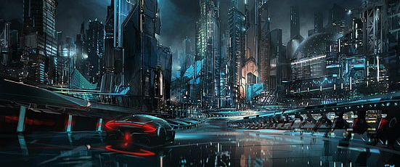
Future of Smart Cities
The potential is limitless, and the number of smart cities is growing exponentially
There has been technology within cities to help shape the future such as 5G, quantum computing, and blockchain
These technologies will help connect all electrical devices at once which will allow more people to become connected to each other

Slide 14
References
[1] I. Intelligence, “How IoT and smart city technology works: Devices, applications and examples,” Insider Intelligence, Jan. 13 2022. https://www.insiderintelligence.com/insights/iot-smart-citytechnology/ (Accessed Oct 12. 2023)
[2] Oracle, “What is the Internet of Things (IoT)?,” oracle, 2023. https://www.oracle.com/internet-of-things/what-is-iot/ (Accessed Nov. 3. 2023)

Slide 15
References cont.
[3] A. Rujan, “Thinking about becoming a smart city? 10 benefits of smart cities | Explore Our Thinking | Plante Moran,” Plantemoran.com, Apr. 03, 2018. https://tinyurl.com/2kpmmf96 (accessed Nov. 11, 2023)

